Slide 1
Object Recognition Project
By :
Sri Harshitha N V N S
Rohan Arora
Meghana Duguru
Harshini M
Ashutosh Dubey
Mentor:
Anil Shaw
Infosys Springboard

Slide 2
Index
Introduction
Methodology
Model Training
System Setup and Design
Tools Used
Conclusion
Future Scope

Slide 3
Introduction
Object recognition is a significant task in computer vision, where the goal is to identify and locate objects in images or video streams. In this project, we focus primarily on YOLO (You Only Look Once) due to its efficiency and real-time processing capabilities. Additionally, comparisons are drawn with Fast R-CNN and Mask R-CNN, which were also implemented and evaluated.
The primary focus of the project is to:
Train models using these algorithms.
Evaluate their performance.
Design an interface to showcase the real-time object recognition system using YOLO.
YOLO has been widely adopted in applications requiring high-speed and reliable object detection, such as surveillance systems, autonomous vehicles, and industrial automation.

Slide 4
Methodology

Slide 5
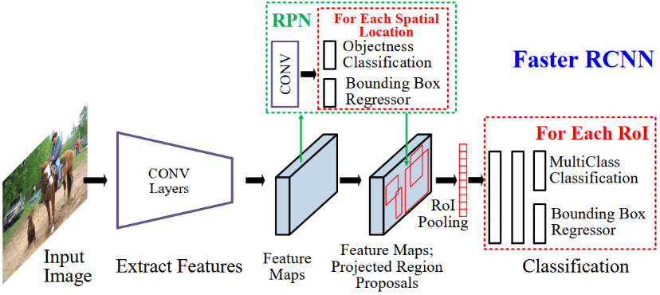
4.1 Fast R-CNN
Fast R-CNN (Region-based Convolutional Neural Network) improves upon the original R-CNN by enhancing efficiency in object detection tasks.
How Fast R-CNN Works:
Region Proposals: Fast R-CNN generates region proposals using algorithms like Selective Search.
Feature Map: The entire image is passed through a convolutional network to generate a feature map.
RoI Pooling: Regions of interest (RoIs) are pooled from the feature map and passed through a fully connected layer.
Prediction: The network predicts the class of the object in each region and refines the bounding box coordinates.

Slide 6
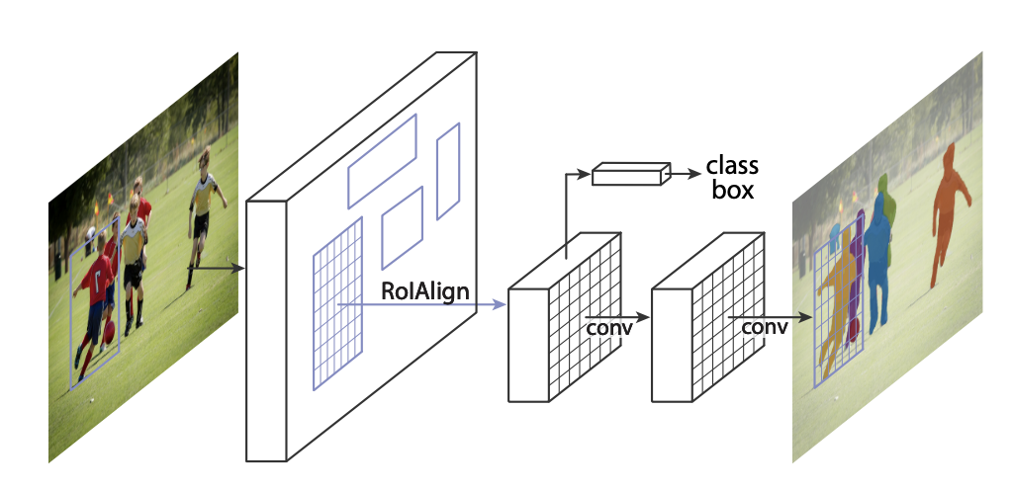
4.2 Mask R-CNN
Mask R-CNN is an extension of Fast R-CNN that adds pixel-wise object segmentation, making it suitable for tasks that require precise object boundaries.
How Mask R-CNN Works:
Region Proposal Network (RPN): Automatically generates region proposals from the input image.
RoI Align: Improves upon RoI Pooling by preserving spatial precision.
Segmentation Mask: In addition to classifying objects and predicting bounding boxes, Mask R-CNN predicts a segmentation mask for each object.

Slide 7
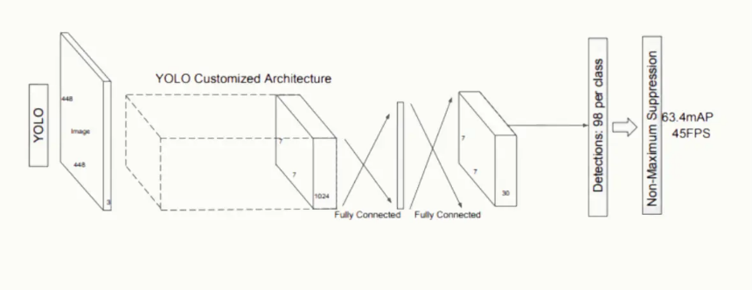
4.3 YOLO (You Only Look Once)
YOLO is a real-time object detection system that focuses on speed and efficiency. Unlike Fast R-CNN, which processes regions individually, YOLO treats object detection as a single regression problem.
How YOLO Works:
Grid-based Prediction: The image is divided into an grid, and each grid cell predicts bounding boxes and class probabilities.
Unified Architecture: A single CNN predicts bounding boxes, object confidence, and class labels simultaneously.
Non-Maximum Suppression: After predictions, redundant boxes are removed using NMS to retain the most confident predictions.

Slide 8
Model Training

Slide 9
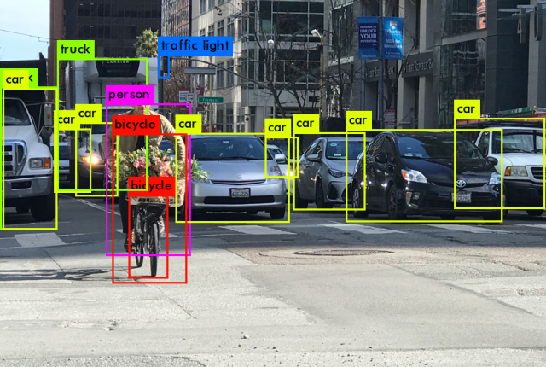
5.1 Training Process for Fast R-CNN
Dataset: The model is trained using annotated datasets with bounding boxes around objects.
Loss Function: The model uses a multi-task loss that combines classification loss (cross-entropy) and bounding box regression loss (smooth L1).
Optimization: Training is done using Stochastic Gradient Descent (SGD) with a learning rate scheduler.
Data Augmentation: Techniques like scaling, flipping, and cropping are used to augment the dataset and prevent overfitting.

Slide 10
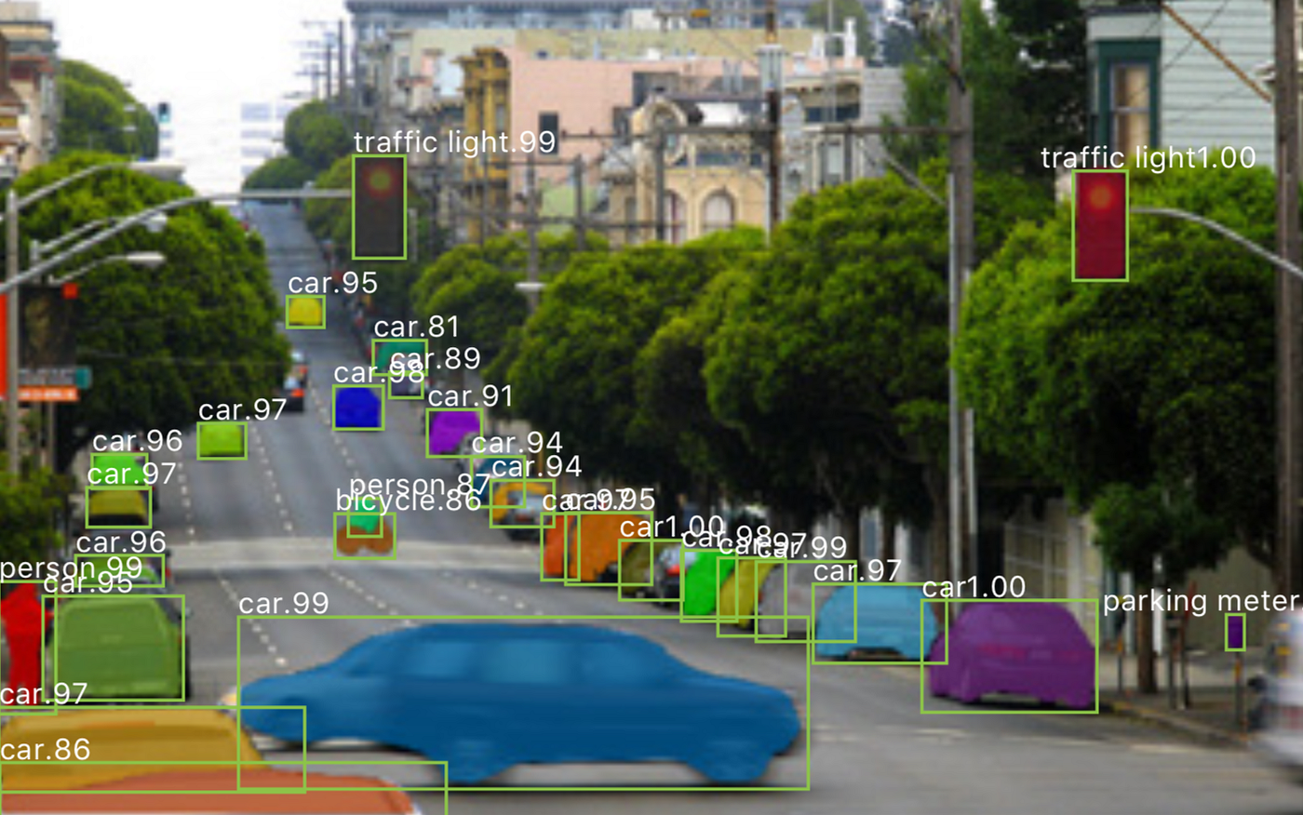
5.2 Training Process for Mask R-CNN
Dataset: The dataset must have labeled segmentation masks in addition to bounding boxes.
Loss Function: The model uses a combination of classification loss, bounding box loss, and mask loss (binary cross-entropy).
Optimization: Optimized using Adam or SGD.
Training Approach: Transfer learning can be used by initializing the model with pre-trained weights from a model trained on a large dataset like COCO.

Slide 11
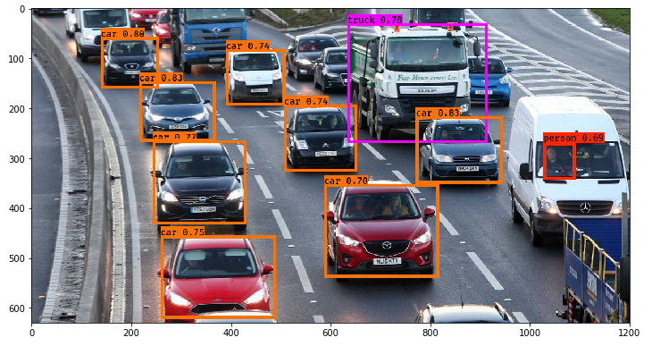
5.3 Training Process for YOLO
Dataset: The images are annotated with bounding boxes and class labels.
Loss Function: YOLO uses a multi-part loss function consisting of localization loss, confidence loss, and classification loss.
Optimization: Typically trained using Adam or SGD.
Data Augmentation: Random cropping, flipping, and color jittering to enhance model robustness.

Slide 12
Setup
Hardware: A system with a CUDA-enabled GPU for faster training.
Software: Python
Dataset: COCO Dataset.
Tools Used
PyTorch: Used for model training and evaluation.
OpenCV: For image preprocessing and video stream handling.
Flask and Streamlit: For developing the web application to interface with the object recognition system.
Matplotlib/Seaborn: For visualization of training results and performance metrics.

Slide 13
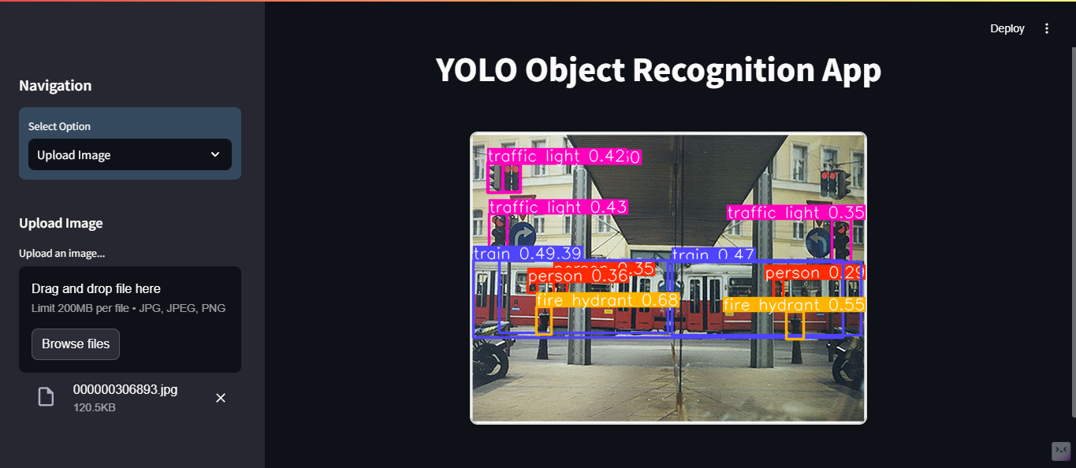
Interface Design
The interface allows users to upload images and receive real-time object recognition results. The interface is built using Streamlit. The results are shown with bounding boxes around detected objects and their respective class labels.

Slide 14
Future Scope
Integration with Edge Devices:
Deploying the YOLO model on edge devices like Raspberry Pi and NVIDIA Jetson Nano to enable localized and cost-effective solutions.
Expansion to Other Domains:
Leveraging the system for applications in healthcare (e.g., medical imaging), agriculture (e.g., pest detection), and retail (e.g., inventory tracking).
Improved Accuracy for Small Objects:
Enhancing the model's ability to detect smaller objects through advanced techniques like feature pyramid networks (FPN) or hybrid architectures.
Integration with Augmented Reality (AR):
Using object detection in AR systems for immersive experiences in gaming, education, and training simulations.

Slide 15
Conclusion
In conclusion, this project successfully implemented object recognition using YOLO, Fast R-CNN, and Mask R-CNN, each offering distinct advantages for various use cases. Fast R-CNN and Mask R-CNN excel in tasks requiring precise localization and segmentation, while YOLO is ideal for real-time applications due to its speed. The real-time object recognition system developed in this project can be further expanded for real-world applications in fields such as surveillance, autonomous driving, and robotics.

Slide 16
Thank You

